Slide 1
LECTURE 3: CULTURE

Slide 2
Outline
Introductory Concepts and Definitions
Some Elements of Culture
The Three Main Sociological Perspectives on Culture

Slide 3
Introductory Concepts and Definitions
Culture: “everything but the natural environment around us”
  The ways of thinking, the ways of acting, and the material objects that together form a people’s way of life
  This includes a society’s collection of:
    Social categories & concepts we embrace
    Values, Beliefs
    Knowledge
    Norms, Behaviors
    Language
    Material objects
  Shared by a people and socially transmitted from generation to generation.

Slide 4
Introductory Concepts and Definitions
Society:
    A group of people who:
      live together in a defined territory
      are united by social relationships
      share a culture
“Society” and “Culture” go hand in hand, but they ARE NOT THE SAME THING.
***Cultures describe societies.

Slide 5
Introductory Concepts and Definitions
Culture:
  The most pervasive element of society
  A society’s “personality”
  It colors everything we experience …it affects our very perceptions of reality
    This is why we may experience difficulties communicating across cultures
  We often aren’t fully conscious of the culture in our lives until someone questions it or violates it

Slide 6
Introductory Concepts and Definitions
Culture: …
  shapes what we do
  helps form our personalities
  is shared, learned, and taken-for-granted
  is symbolic
  varies across time & place
  informs our definition of what is “normal”
    Revealed when we experience “culture shock”

Slide 7
Introductory Concepts and Definitions
Culture Shock: the experience of being disoriented because of a lack of knowledge about an unfamiliar social situation or way of life
  It is the inability to read meanings in new surroundings.

Slide 8
Outline
Introductory Concepts and Definitions
Some Elements of Culture
The Three Main Sociological Perspectives on Culture

Slide 9
The Elements of Culture
Material culture:
    The physical or tangible objects produced by people in a particular culture (constructed physical environment and objects)
Nonmaterial culture: (symbolic culture)
    The abstract or intangible objects (ideas) of a culture, including values and beliefs, accumulated knowledge about how to understand and navigate the world, and standards or “norms” about appropriate behavior

Slide 10
The Elements of Culture
Material culture
Nonmaterial culture
Ideas, values, behaviors may lead to the invention of material culture
New material culture may lead to new non-material culture (changes our values, the way we interact, leads to new ideas)

Slide 11
iClicker
Can your remember a time when the internet was not an integral part of your life? Answer the following: How much did your parents restrict your access to the internet growing up?
  A. Not at all
  B. A little bit
  C. Sometimes
  D. Very much
  E. All the time

Slide 12
The Elements of Culture
Items (material culture) in a culture do not have inherent meaning – we assign meaning to them.
Nonmaterial culture works in a similar way – as a society we determine the values, beliefs, behaviors, and social norms that we find appropriate and acceptable.
Culture includes language, the meanings we assign to words, and concepts such as class, inequality, and ownership.

Slide 13
The Elements of Culture
Nonmaterial culture includes ideology: a system of concepts and relationships that includes an understanding of cause and effect.
    A system of meaning that helps define and explain the world and that makes value judgments about that world (a worldview)
    4 main functions of ideology
Dominant ideology:
    A widely held and regularly reinforced set of assumptions that generally support the current social system and serve the interests of authorities

Slide 14
The Elements of Culture
Ex: Ideology may influence our viewpoints on certain scientific issues net of education and general science literacy
  Zia & Todd, 2010: “Evaluating the effects of ideology on public understanding of climate change science: How to improve communication across ideological divides?(method: survey)
    H1: As citizen’s ideology shifts from liberal to conservative, concern for global warming decreases. (supported)
    H2: citizens with college education and higher general science literacy tend to have higher concern for global warming (not supported)
    H3: college education does not increase global warming concern for those with conservative ideology. (supported)
  Feinburg & Willer 2015: moral reframing

Slide 15
The Elements of Culture
Dominant Culture: a culture that permeates the society and that often represents the ideas and practices of those in positions of power
Subcultures: cultures associated with smaller groups in the society that have distinct norms, values, and lifestyles that set them apart
Counterculture: culture which champions values and lifestyles distinctly opposed to those of the dominant culture
EXAMPLES?

Slide 16
The Elements of Culture:
Communication
Communicating Culture:
  Symbol: anything that represents something else
  Language: an elaborate system of symbols that enables complex communication
  Dialect: A variant of a language with its own accent, vocabulary, and in some cases grammatical characteristics

Slide 17
The Elements of Culture:
Non-Material Culture
Knowledge: the range of information, awareness, and understanding that helps us navigate our world
Cultural Capital: forms of knowledge; skill; education; any advantages a person has which give them a higher status in society, including high expectations.
  Exists in three forms: embodied state, objectified state, institutionalized state

Slide 18
The Elements of Culture:
Non-Material Culture
Value: a deeply held principle or standard that people use to make judgments about the world, especially in deciding what is desirable or worthwhile
  Values of American culture?
Culture War: an intense disagreement within a society about core values and moral positions
  US examples of culture wars?

Slide 19
The Elements of Culture:
Non-Material Culture
Culture Wars (continued)
  Disagreement is often regarding at least one of the following:
    Which values should take precedent when one value conflicts with another?
      Ex: religious liberty vs. equal protection under the law
    What is the proper interpretation of core values?
      Ex: how to interpret Establishment Clause and Free Exercise Clause of first amendment: “Congress shall make no law respecting an establishment of religion or prohibiting the free exercise thereof”

Slide 20
The Elements of Culture:
Non-Material Culture
The values of American Culture (CONTINUED)
Values within one society are frequently inconsistent and even opposed to one another.
When central values of different cultures are in conflict, the conflict is more intense.

Slide 21
The Elements of Culture:
Non-Material Culture
Ex: Prayer in Public Schools
  Supreme Court Decisions:
    1947 - Everson v Board of Education: “wall of separation”; broader interpretation of the Establishment clause
    1948 - McCollum v Board of Education: “a high and impregnable wall” between church and state
    1952 – Zorach v Clauson: Establishment Clause does not require a “callous indifference to religion”
    1962 – Engel v Vitale: unconstitutional to begin school day with a prayer drafted by school officials (even if students given choice of participation)
  Subsequent cases have shown SCOTUS is willing to strike down any practices that might be likely to be perceived either as coercive or as state endorsement of religion.

Slide 22
The Elements of Culture:
Non-Material Culture
Ex: Prayer in Public Schools
  What values are coming into conflict in this “culture war”?

Slide 23
The Elements of Culture:
Non-Material Culture
Jelen & Wilcox (1997): Typology of Attitudes toward Church-State Relations

Slide 24
The Elements of Culture:
Non-Material Culture
Beliefs: the specific convictions or opinions that a culture’s people generally accept as being true (values often underlie the beliefs people hold)
  Examples:
    “My country is good”; “That country is evil”
    “God exists”; “God has no place in government”; “the gods exist”; “God does not exist”
    “A woman’s place is in the home”; “A qualified woman could serve as president”

Slide 25
The Elements of Culture:
Non-Material Culture
Values, Beliefs, Knowledge, and Norms continued
  Norms: a culture’s rules and expectations for “appropriate” behavior
    Mores: norms that are strictly enforced, with potentially severe penalties for violating them
    Folkways: group habits or customs that are common in a given culture
  Culture lag: the ways that new technological developments often outpace the norms (and laws) that govern our collective experiences with these new technologies (EXAMPLES?)

Slide 26
Cultural Diversity
Sociologist should take caution to not be judgmental of other cultures
  Ethnocentrism: the judgment of other cultures by the standards of one’s own on the assumption that one’s own is superior
  Xenophobia: the unreasonable fear
  and hatred of foreigners or people from other cultures
  Cultural Relativism: the practice of understanding a culture by its own standards

Slide 27
Outline
Introductory Concepts and Definitions
Some Elements of Culture
The Three Main Sociological Perspectives on Culture

Slide 28
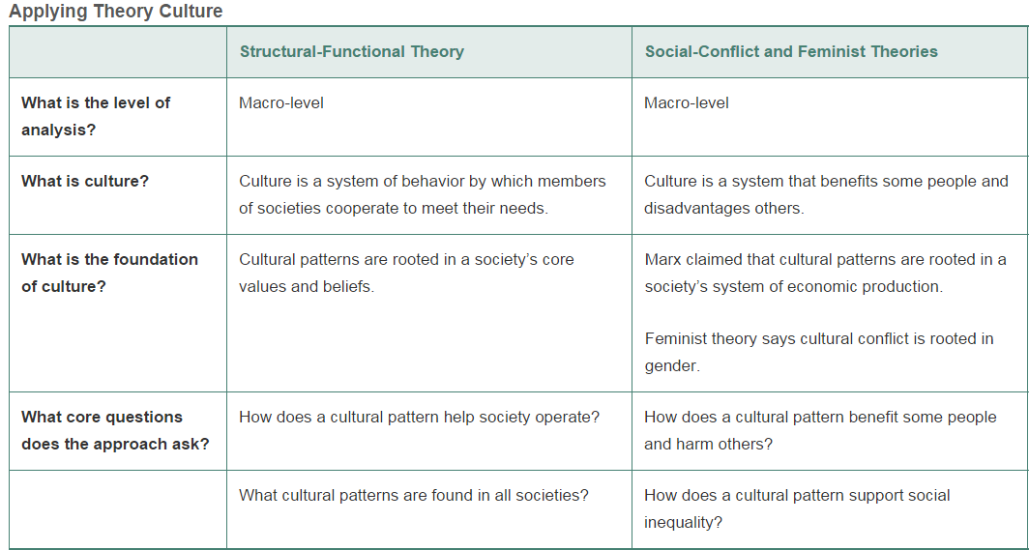
Sociological Perspectives on
Culture
Review
Symbolic Interactionism
Micro-level
Culture is generated, sustained, and changed in a society by people through interaction
Rooted in everyday interaction and socialization processes.
Mead says that we can begin to see culture as “received symbols, recipes, and products that actors draw on by way of grappling in emergent meaningful ways with situational problems”
How do meanings of symbols and behaviors change overtime through interaction?
Why/how do people react to violations of shared social norms?

Slide 29
Sociological Perspectives on
Culture
Structural-Functionalist
  Culture directs our lives, gives meaning to what we do, and binds us together
  Example: Sports as Culture
    How does sports bring us together? How can sports give meaning to what we do?
    How can sports produce consensus, stability in society?
    How might other perspectives approach the role of sports in society? Social Conflict? Symbolic Interactionist?

Slide 30
Sociological Perspectives on
Culture
Social-Conflict
  Dominant ideologies influence culture, creating patterns that support inequality
    Ex: Media is controlled by those in power
      How does the control of media by a few corporations help to perpetuate power and dominant culture in society?
      How may a structural functionalist approach the issue of media/cultural control? Symbolic Interactionism?

Slide 31
Sociological Perspectives on
Culture
Social-Conflict (continued)
  Hegemony: a condition by which a dominant group uses its power to elicit the voluntary “consent” of the masses.
    It is achieved when the subordinate are led to consent to a system that subordinates them
    Ex: American Dream; Belief in Consumerism

Slide 32
Sociological Perspectives on
Culture
Symbolic-Interactionist
  Our daily lives are structured by the changing symbols and meanings of many groups
  Ex: Media as a source of socialization and identity → effects on roles/behavior
    How does the media affect the way people see themselves and others?
    How might the media affect how people interact with each other in everyday life?
  Ex: difficulties communicating across cultures

